Slide 1
Predicting workplace accidents with data mining
Notes:
Autofill to automate data process

Slide 2
Introduction
1. Predicting Incident Type (TF1-TF3) and Incident Location
Missing data fixed by CART
Algorithms
Multinomial Regression
Random Forest
Bayesian network
Results
Useful Features
Conclusions

Slide 3

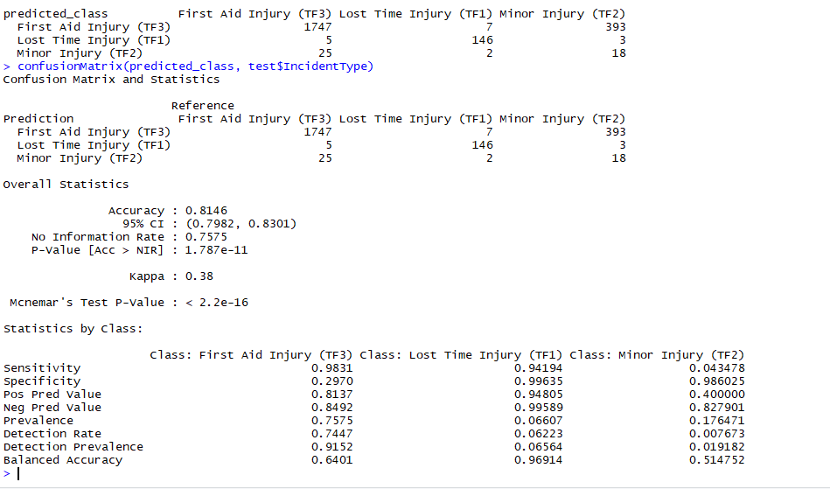
Multinomial regression
Assigns a probability of being classified for each class.
Choose the class with the highest probability. It uses a softmax function:(Zi = Class i)
Good performance on TF1s, and satisfactory on TF3s
In absence of knowing “TotalDaysUnfitForWork” it predicts only TF3.
Notes:
Next time add some regularisation to it to reduce the bias

Slide 4
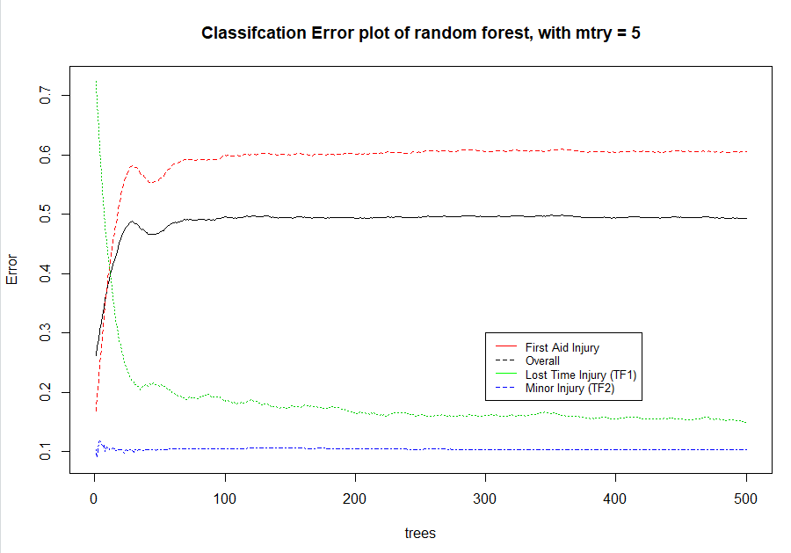
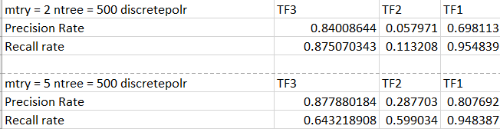
Random Forest
Ensemble of decision trees
Randomly sample from a number of variables (mtry)
With these variables a decision tree is modelled and prediction done by majority voting
Notes:
Precision= #correct positives / #totalpredicted positives
Recall = #Correct positives/Total True positives
81% precision TF1s
95% recall on TF1s
TF2 Prediction improves with a higher mtry (More complexity) although it leads to a lower TF3 recall rate.
It performs well even with removal of many variables (totaldaysunfitforwork) and variables deemed unimportant
Mtry = 5 overall performs better than mtry =2.

Slide 5
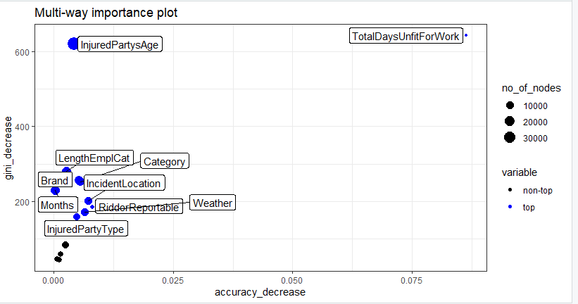
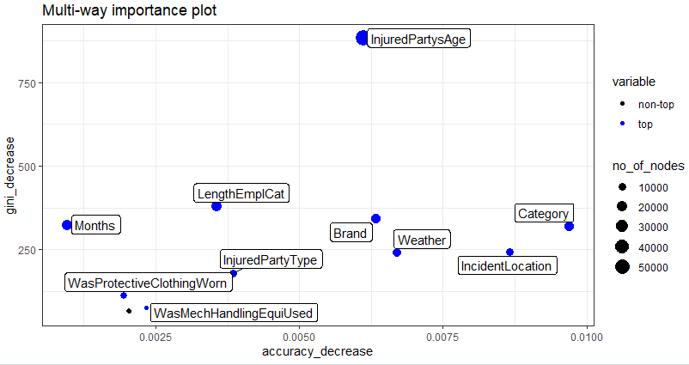
Random Forest Variable importance
With TotalDaysUnfitForWork
Without TotalDaysUnfitForWork
Notes:
Put some emphasis on it being totaldaysunfitforwork

Slide 6
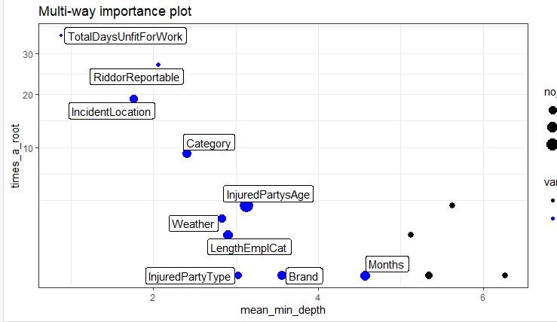
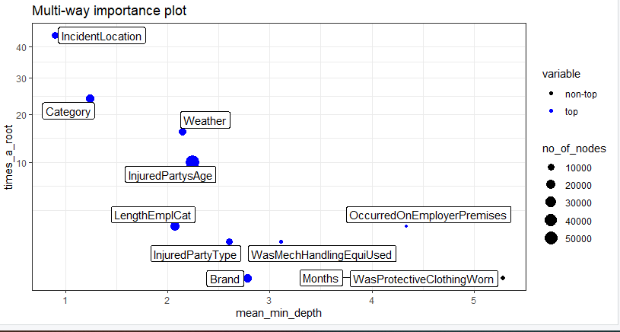
Comparing mean_min_depth and frequency of root node
With TotalDaysUnfitForWork
Without TotalDaysUnfitForWork

Slide 7
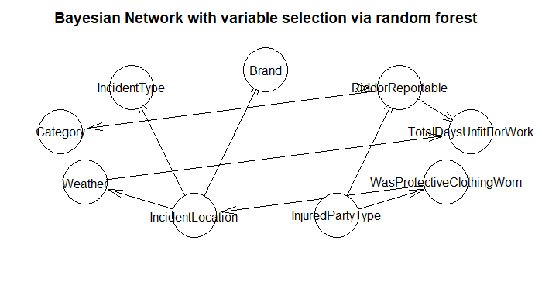

Bayesian network
Creates a collection of conditional dependencies between variables
Learning of the network through data (Hill Climb, Tree Augmented Naive Bayes)
Prediction done in R
Prediction struggles with TF2
Notes:
Variable selection is an alternative way to avoid cycles
Can do variable selection by sensitivity to findings

Slide 8
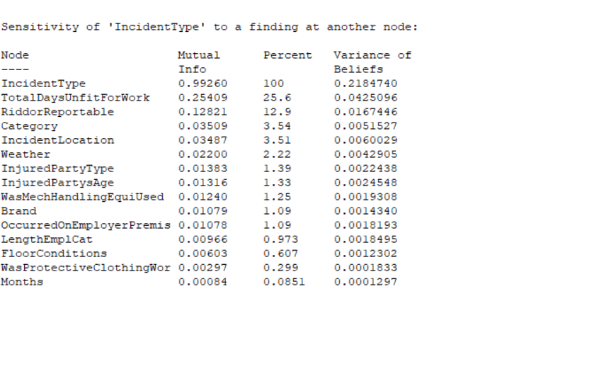
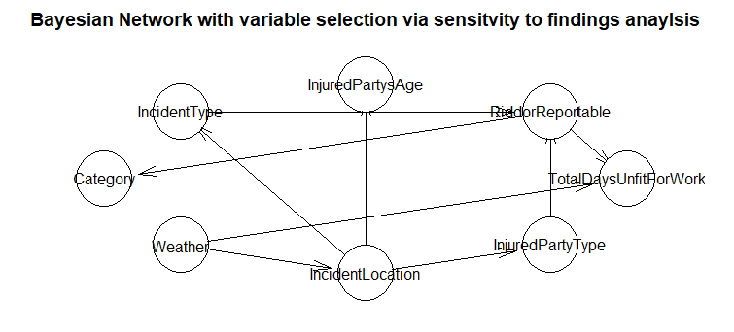

Sensitivity to findings

Slide 9
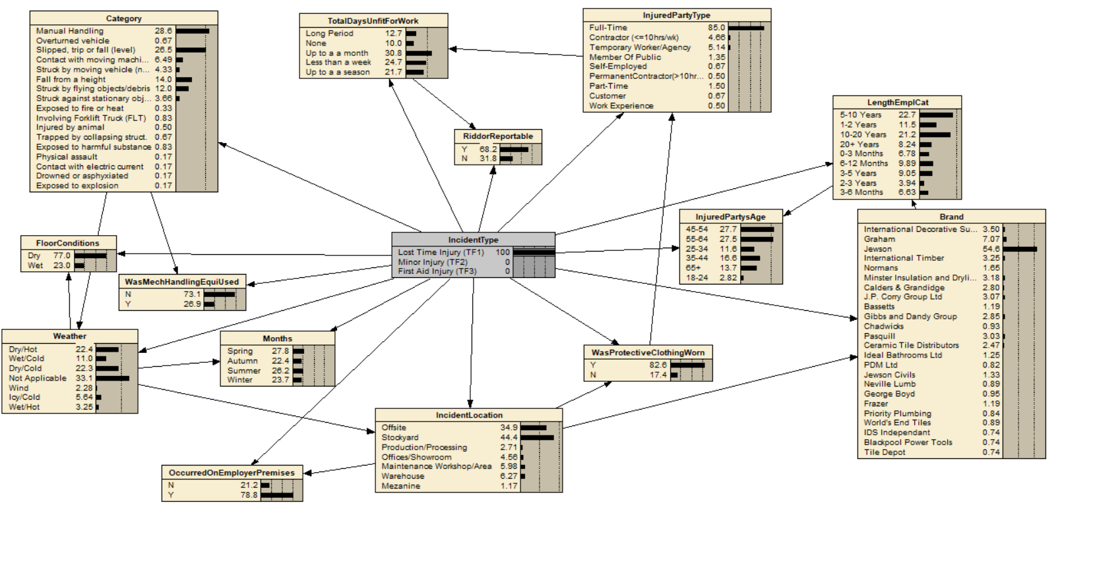
What if analysis
Force a node to take a certain value (decision)
And observe how the other values of the network changes.

Slide 10
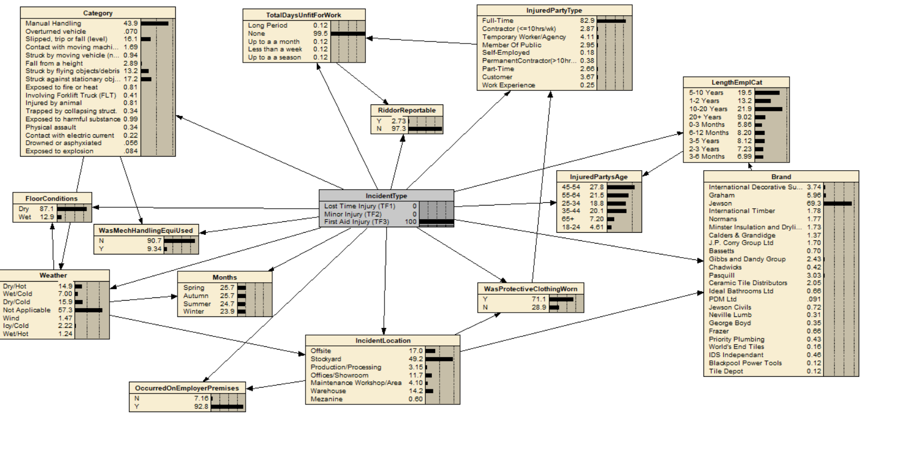

Slide 11
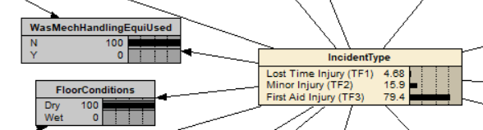
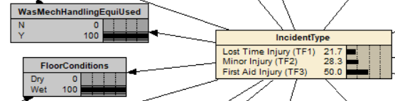
What if analysis
Using mechanical equipment in wet conditions has a higher risk of severe injuries
Increased chance of Lost Time Injuries (TF1) due to being self-employed, on work experience or contractors. On the flipside members of public, part-time/customers have more First Aid Injurys (TF3).
A few brands appear to have a higher risk of severe injuries eg Tile Depot, Blackpool Power Tools and PDM having 20-30% of incidents being Lost Time Injuries (TF1).
Severe categories include accidents involving moving vehicles, slips from heights have 20-30% of incidents being Lost Time Injury.
Dry conditions, no mechanical equipment Wet conditions, Yes Mechanical Equipment
Notes:
Mechanical equipment wet conditions
Self employed, work experience contracots
Members of public, part-time/customers
Tile depot, blackpool powertools, pdm
Moving veichles, slips from heights
Using mechanical equipment in wet conditions has a higher risk of severe injuries
Increased chance of TF1s due to being self-employed, on work experience or contractors. On the flipside members of public, part-time/customers have more First Aid Injurys (TF3).
A few brands appear to have a higher risk of severe injuries eg Tile Depot, Blackpool Power Tools and PDM having 20-30% of incidents being Lost Time Injury (TF1).
Severe categories include accidents involving moving vehicles, slips from heights have 20-30% of incidents being Lost Time Injury.

Slide 12
Conclusions
Random Forest performs well with some access to variable explanation
Bayesian network offers flexibility in what if analysis to see how decisions (conditions) affect the likelihood of accidents
Multinomial logistic regression does not work well in a setting with lots of categorical variables
Incident Location, Category are important predictors for Incident Type
Notes:
Brands to be more likely – focus on this pointing risk brands
Data collection recommendations
Priority on tf1s

Slide 13
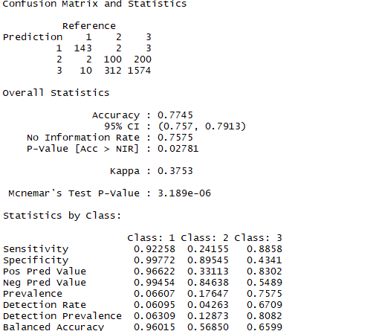
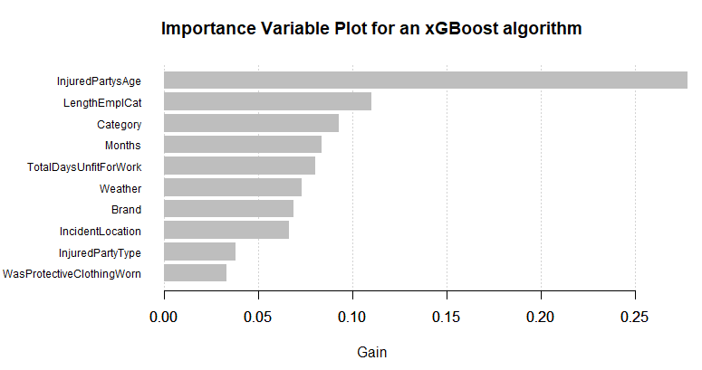
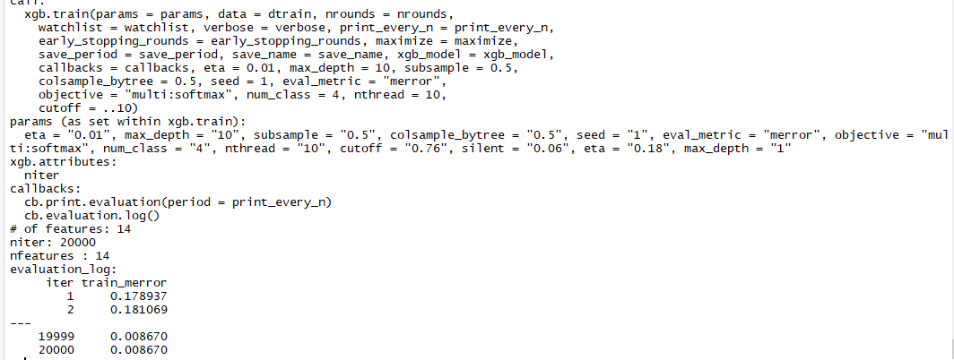
XGBoost
A gradient boosted decision tree algorithm
Performs well on test data despite requiring numerical inputs
Struggles with prediction on TF2, with very good TF1 prediction
Ran to minimise merror (~ 20000 iterations)
Development needed in terms of its interpretability

